Slide 1

Branch - CSE Python Programming
Lecture – 24 Frozen Sets
By
Dr. Smita Tiwari
Assistant Professor
Department of Computer Science and Engineering
School of Engineering & Technology

Slide 2
Python frozenset()
Python frozenset is an unordered collection of distinct hashable objects.
Frozenset is an immutable set, so it’s contents cannot be modified after it’s created.

Slide 3
Python frozenset()
Python frozenset() function is used to create frozenset object. It’s syntax is:
If the input iterable argument is provided, then frozenset is created from the iterable elements.
If no argument is provided, then an empty frozenset object is returned.

Slide 4
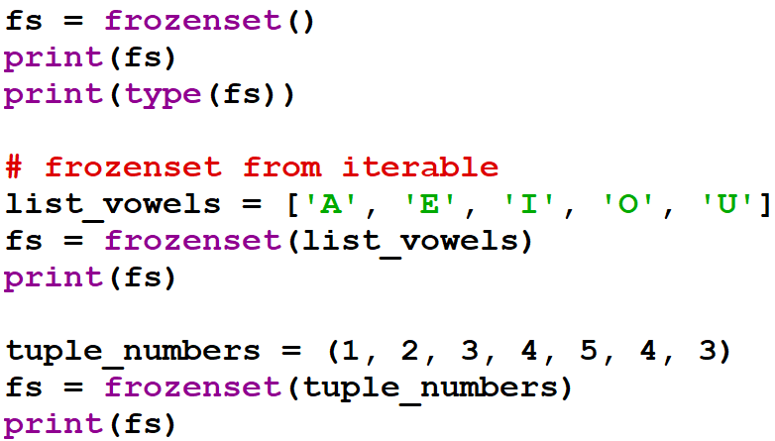
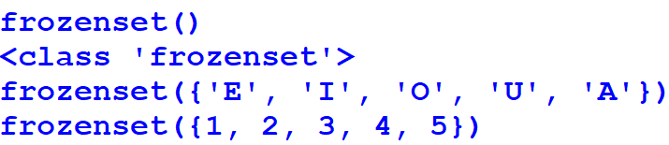
Python frozenset() example
Output

Slide 5
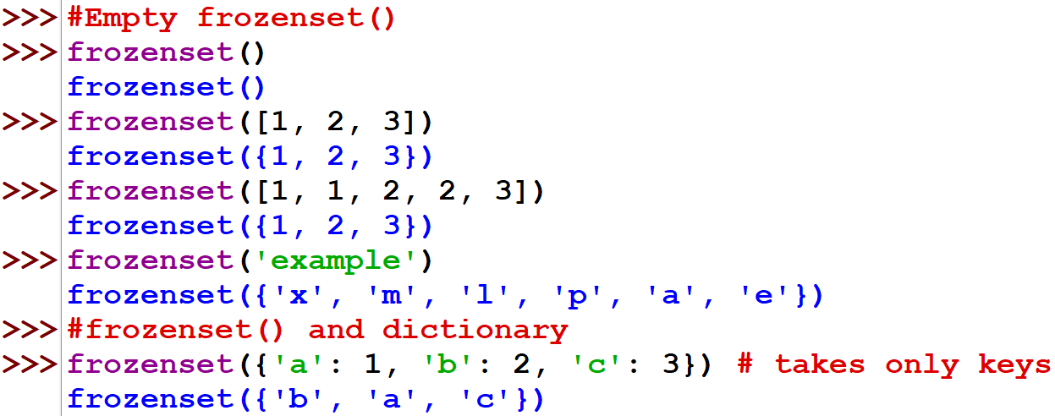
Python frozenset() example

Slide 6
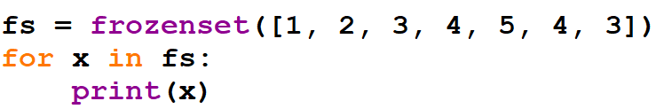
Iterating frozenset elements
We can use the ‘for’ loop to iterate through frozen set elements.
Output:
Note that the duplicate elements are removed while frozenset is being created.

Slide 7
Python frozenset functions
Since frozenset is immutable, there are no methods available to alter its elements. So add(), remove(), update(), pop() etc. functions are not defined for frozenset.
Let’s look at some of the methods available for the frozenset object.
len(fs): returns the number of elements in the frozenset.
x in fs: returns True if x is present in fs, else returns False.
x not in fs: returns True if x is not present in fs, else returns False.

Slide 8
Python frozenset functions
isdisjoint(other): returns True if the frozenset has no elements in common with other. Two sets are disjoint if and only if their intersection is the empty set.
issubset(other): returns True if every element of the set is present in the other set, else returns False.
issuperset(other): returns True if every element in other is present in the set, else returns False.
union(*others): returns a new frozenset object with elements from the frozenset and other sets.

Slide 9
Python frozenset functions
intersection(*others): returns a new frozenset with elements from this set and all the other sets.
difference(*others): returns a new frozenset with elements in the frozenset that are not in the other sets.
symmetric_difference(other): return a new frozenset with elements in either the frozenset or other but not both.

Slide 10
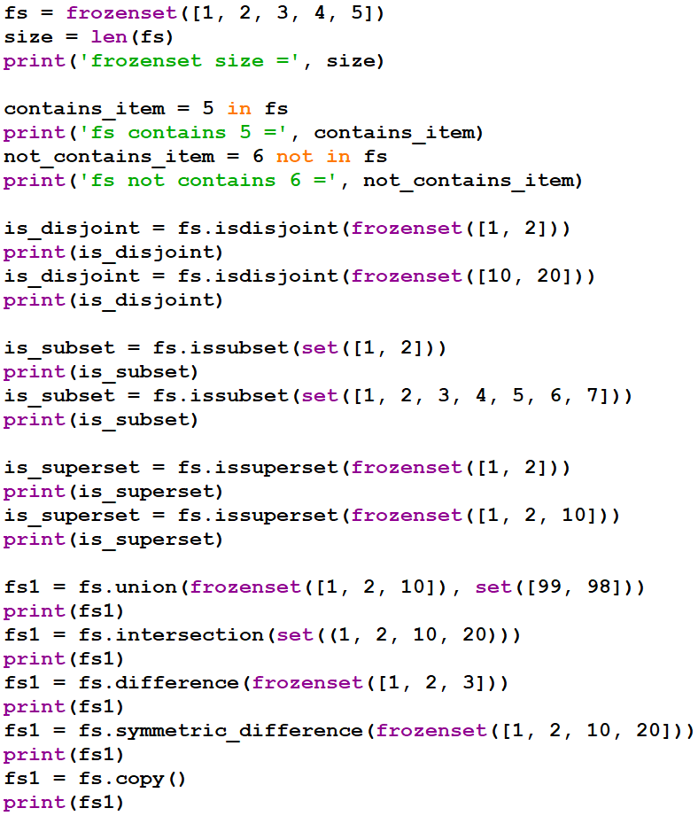
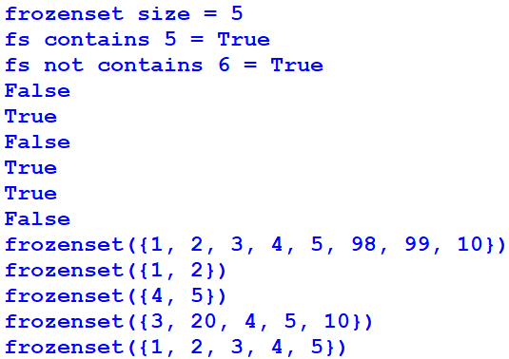

Slide 11
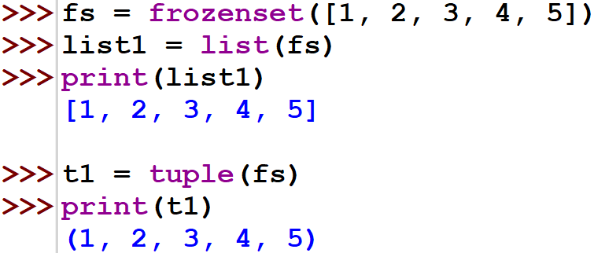
Python frozenset to list, tuple
We can easily create list and tuple from frozenset object using built-in functions.

Slide 12
THANK YOU

